Slide 1
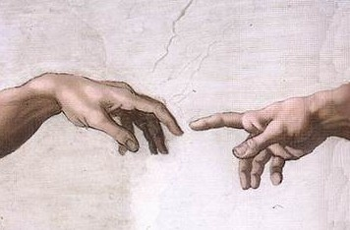
Michaelangelo (c.1512)
Detail The Creation of Adam Sistine Chapel. 280 cm × 570 cm
https://en.wikipedia.org/wiki/The_Creation_of_Adam#/media/File:Michelangelo_-_Creation_of_Adam_(cropped).jpg

Slide 2
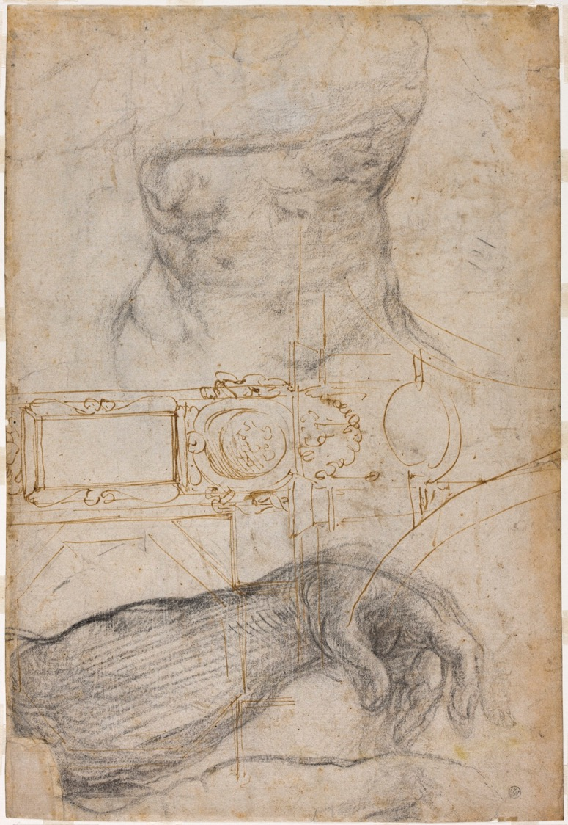
Michaelangelo (c.1508) scheme for Decoration of the Sistine Chapel pen and brown ink and black chalk on cream laid paper. 37.3 × 25.1 cm. https://www.dia.org/art/collection/object/scheme-decoration-ceiling-sistine-chapel-54588

Slide 3
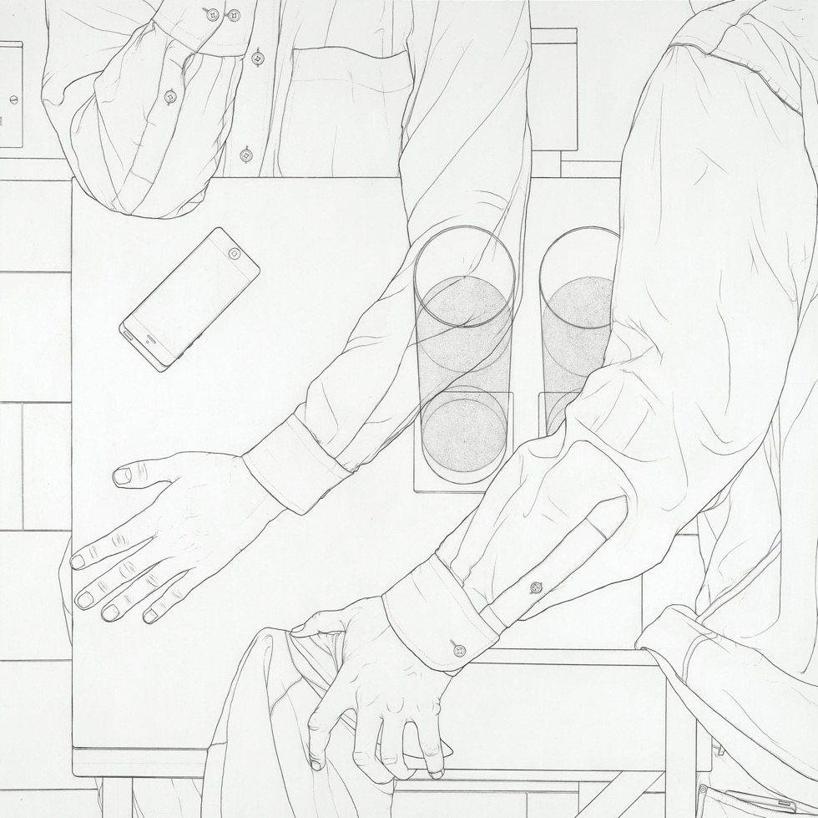
Michael Ditchburn (2018) One sat, another sitting. Graphite on paper
https://blog.britishmuseum.org/pushing-paper-an-introduction-to-contemporary-drawing/

Slide 4
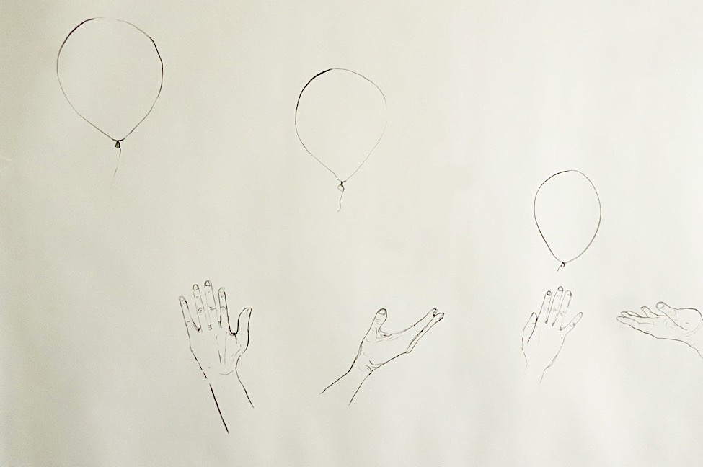
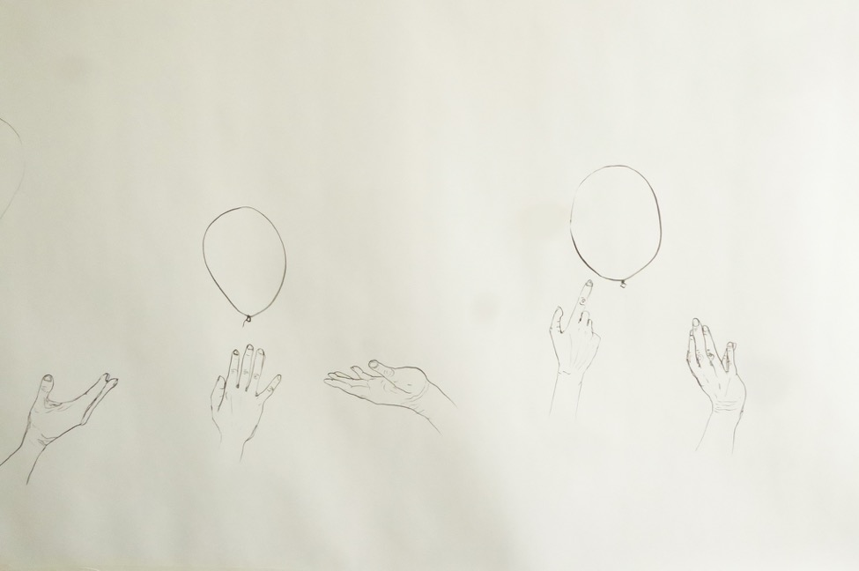
Clare Palmier (2021) The Balloonist (detail). Ink on paper.

Slide 5
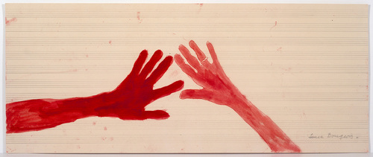
Louise Bourgeois (1970/1975) Untitled (no. 15 and no. 6) from the series 10 AM Is When You Come to Me
Soft ground etching, with watercolor and pencil additions on music paper; staves drawn in pencil. 37.8 × 90.5 cm. https://www.moma.org/s/lb/collection_lb/object/object_objid-203865.html

