Slide 1
Diversity and Inclusion
Part 1 Introduction
Dr Ivana Lessner Listiakova
BA Childhood
Notes:
Script:
Hello, my name is Ivana, I am a senior lecturer in the BA Childhood. My area of expertise is supporting children with special educational needs and disabilities. In this session we will talk about diversity and inclusion. We will think about inclusion as a value in education based on children’s rights. And we will also talk about practical strategies how to meet the needs of all children in the classroom and other settings so that they can enjoy play and learn more.

Slide 2


Diversity and inclusion
We are all different
Inclusion is a concept based on people’s / children’s rights to participate.
Notes:
Script:
Inclusion is a concept based on people’s / children’s rights to participate.
We participate in different things that depend on our age and the roles we have in our lives, our interests. We should be able to participate in the things that we want to be part of.

Slide 3
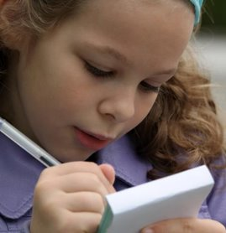
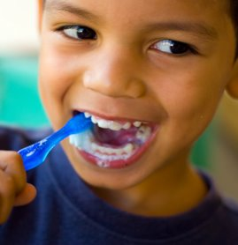
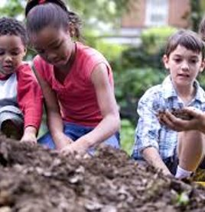
What activities do children participate in?
Notes:
Script:
Children participate in self-care, play and learning. It happens in an interaction with the world, with the physical environment and with people, with the social environment. Sometimes there are barrier in these environments. It can be more difficult for children to overcome these barriers if they have a SEN/D.

Slide 4

Rights of children
United Nations Convention on the Rights of the Child (1989)
Right to education (Article 28)
Right to play (Article 31)
A child with a disability has the right to live a full and decent life with dignity and, as far as possible, independence and to play an active part in the community (Article 23)
Notes:
Script:
It is the right of children to participate in these activities. The United Nations Convention on the Rights of the Child includes for example the right to education and the right to play. It also says that children with disabilities have a right to a full life with dignity in the community

Slide 5
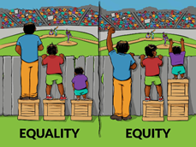
Activity
Discuss the picture.
Think of examples for children with disabilities.
Notes:
Script:
I would like to invite you to work in small groups now.
Discuss the picture.
Think of examples of children with SEN/D.
Be prepared to share with the whole group.
Picture can be printed as a handout
Attribution-NonCommercial 2.0 Generic (CC BY-NC 2.0)
https://www.flickr.com/photos/communityeyehealth/27755848262

Slide 6
Diversity and Inclusion
Part 2 Exploration
Notes:
Script:
In the second part of this session we will reflect on the activity that we just did and explore the ideas around how to support children in the classrooms.

Slide 7
Reflection
Sharing of thoughts and examples
Notes:
Script:
Well done, you have come up with some excellent examples.
It seems that many of you have noticed the inequalities in the world.
If we relate this image to children's learning, we can think of situations where the same way of learning might not work for everyone. So, to treat everyone fairly is not to give everyone the same, but rather give everyone what they need. If we give children what they need they will be able to participate in the same activities, be part of their peer group.

Slide 8
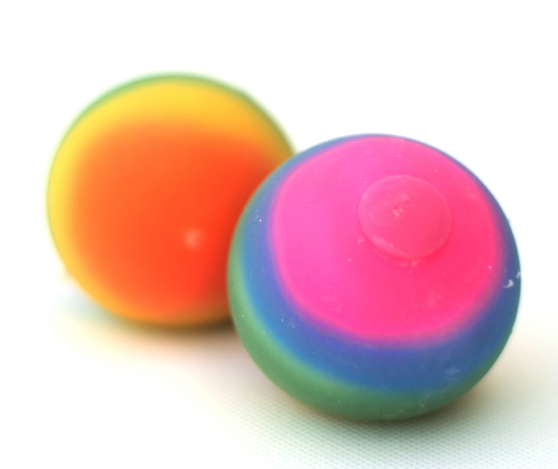
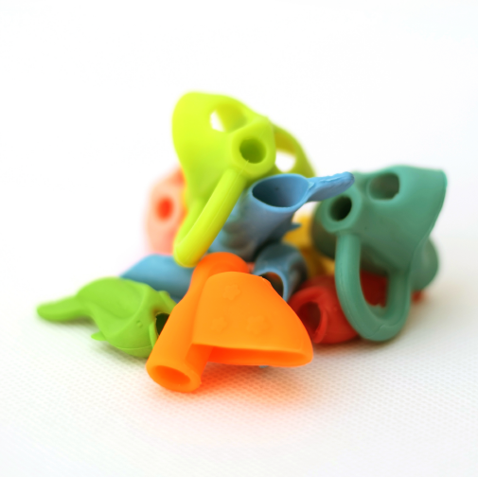
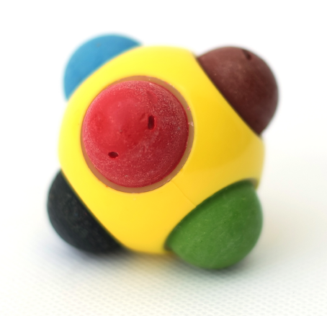
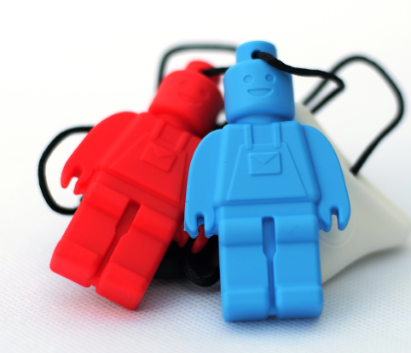
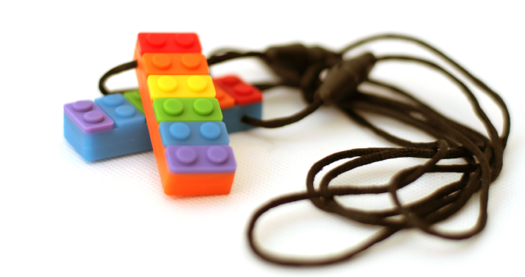
Materials
What is it for?
Why might children need it?
How will it help?
Notes:
Script:
We said that based on their individual needs children might need some help so that they can focus and learn with others.
We have some materials here.
In your groups, think about how these materials could be used to support children?

Slide 9
Diversity and Inclusion
Part 3 Summary
Notes:
Script:
In the third part of this session we will summarise our learning.

Slide 10
Materials
What is it for?
Why might children need it?
How will it help?
Notes:
Script:
Well done. Very creative ideas.
So, let's summarise some of them.
We have these colourful pendants here.
They are called chew necklaces and that's exactly what they are for. Sometimes children can focus and think better when they can chew something. Maybe some of you like to have a pencil in your mouth when you are working on difficult tasks or when you are nervous. These necklaces are a safe way to provide your brain with the stimulation that it needs, so that you can learn.
The stress ball has a very similar function. You can squeeze it when you get frustrated instead of lashing out at your classmates.
Pencil grips support children's handwriting skills, so instead of getting upset that a child is not holding their pencil properly we provide the support, like the crates in the previous activity, so that the activity is easier for children and they participate fully.
The drawing ball is based n a similar idea, generally it is for younger children whose fine motor skills are not yet physically developed, but it can be very useful for some children with disabilities, for example children with physical disabilities such as cerebral palsy that might have difficulties with holding a regular pencil. Having the drawing ball they can participate in drawing like everyone else.

Slide 11

Supporting inclusion
Overcoming barriers
Removing barriers
We are all different
We need different things
We all have a right to participate
Notes:
Script:
To summarise the key messages
In supporting inclusion we are thinking of ways how to support people to overcome barriers or even better how to remove these barriers completely
We are all different so we may need different things
And that’ based on the fact that
We all have a right to participate

