Slide 1
Children and Learning
Welcome and Introduction
Dr Marianna Stella
BA Childhood
Notes:
Script:
Hello, my name is Marianna, I am a lecturer in the BA Childhood and the practice & QTS coordinator. My area of expertise is educational practice and supporting children with special educational needs. In this session we will talk about children and learning. We will think about how children learn and what children can learn from their environment.

Slide 2
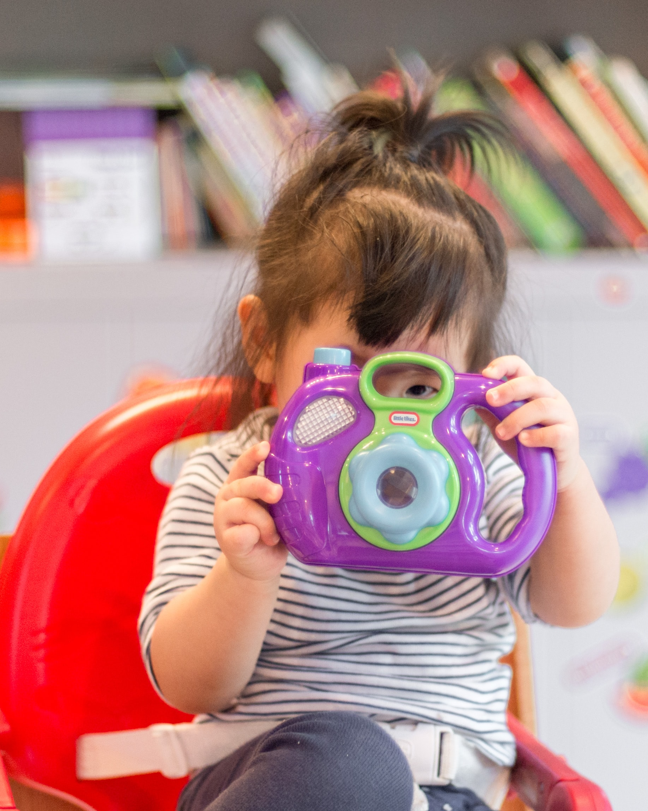
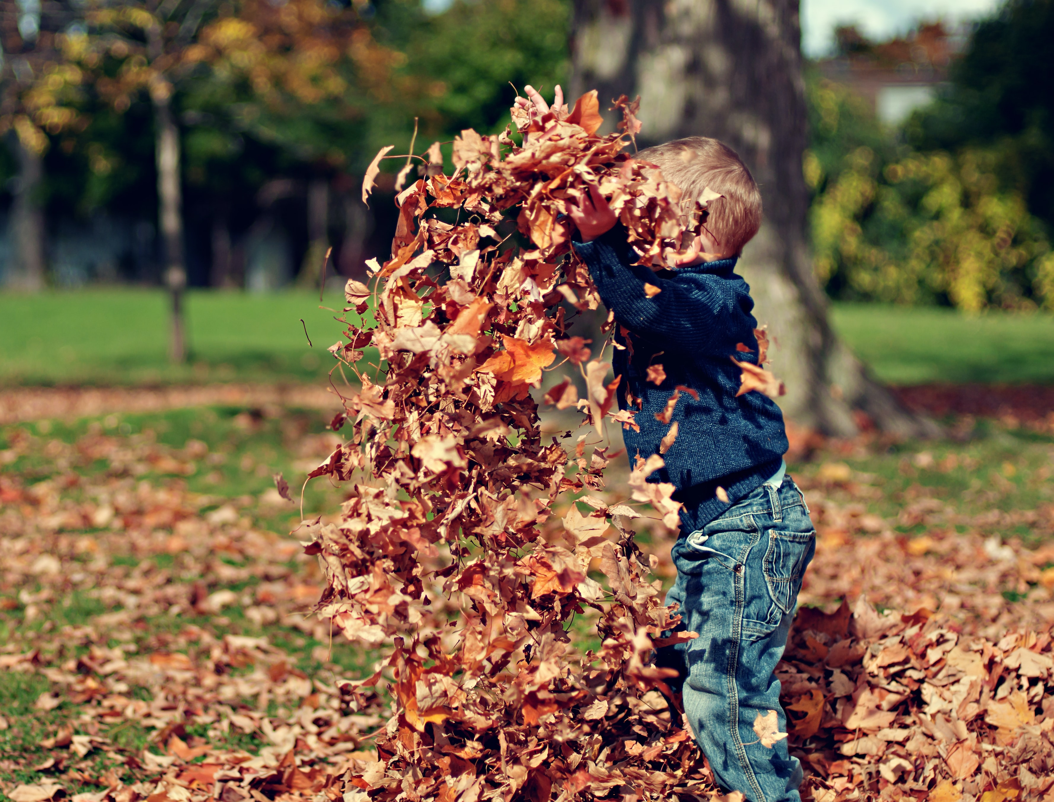
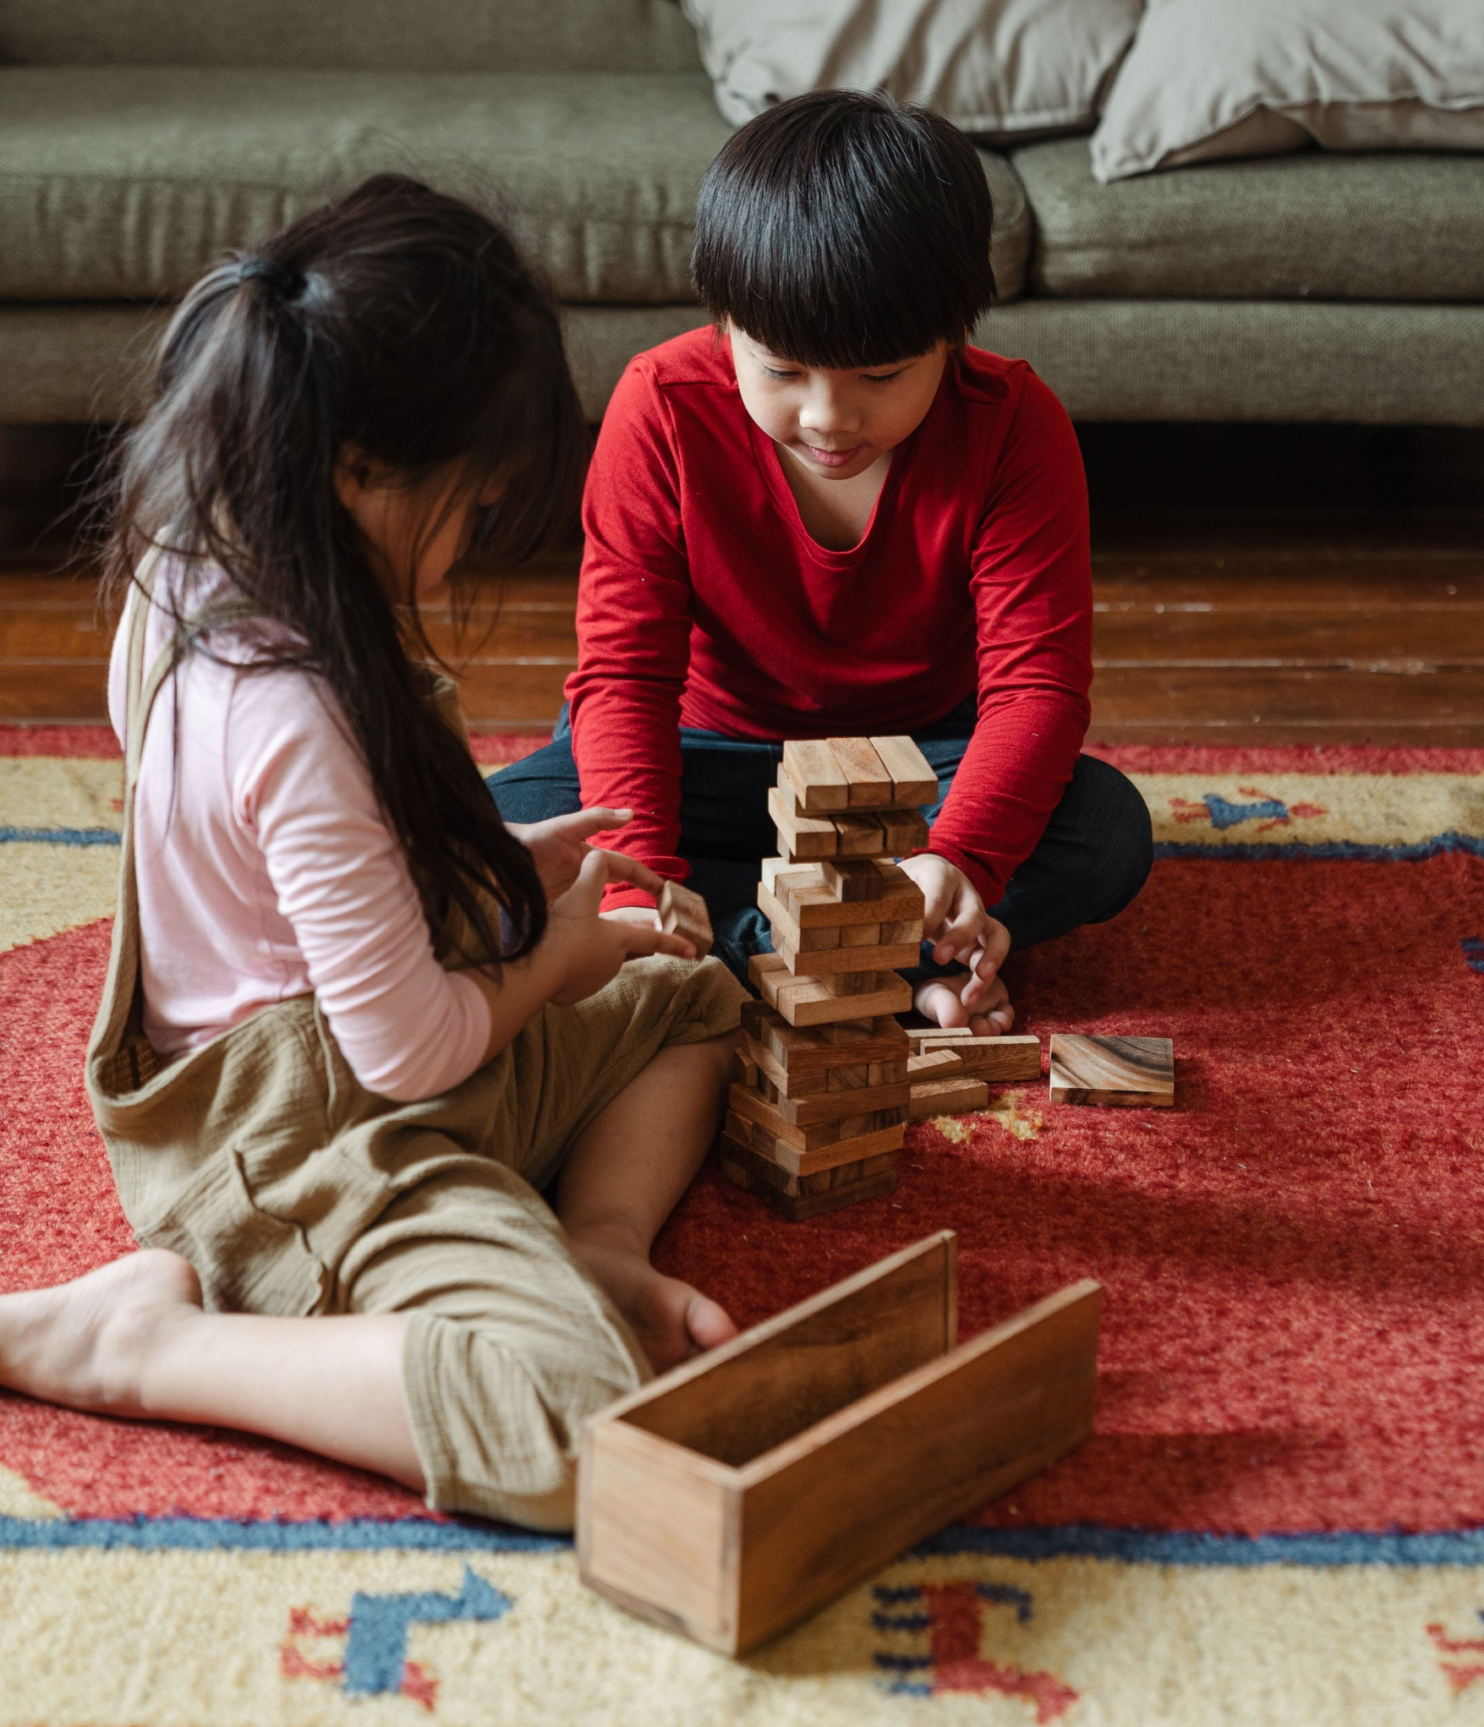
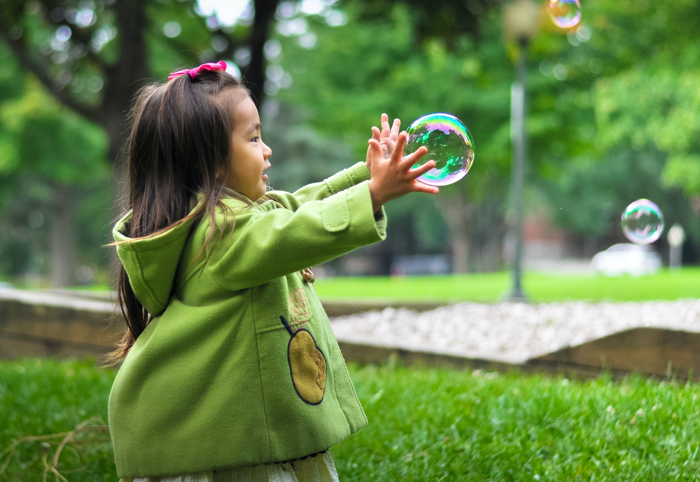

Sometimes we may think about education and learning as being something formal, like going to school
That is not always the case!
Notes:
Script:
Some times when we think about children’s learning, we may think about school and a teacher supporting their learning. Children actually start learning from the moment they are born. They are learning from parents and caregivers about language and communication, motor skills (walking, eating, grasping). Children also learn a lot by interacting with objects and other children. For example the child in the second photo is playing with bubbles. They could learn a lot from this interaction, for example about the texture of bubbles or that they burst when trying to touch them or hold them. That could really help a child practise their fine motor skills as well as use their imagination to play with the bubbles by chasing them or by trying to burst them all as quickly as they can.

Slide 3
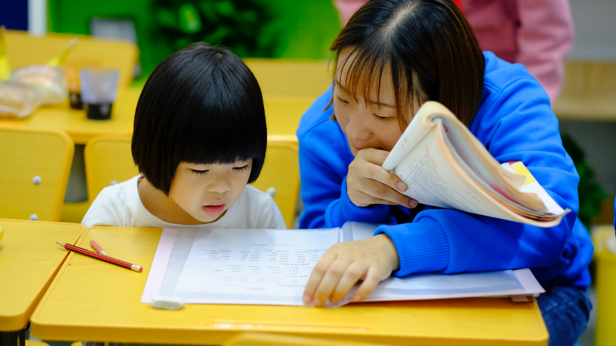
Children and Learning
Activity
BA Childhood
Notes:
Script:
Since we have already had a look at how children could learn from interacting with items in their environment, it is now your chance to think about this with some specific items.

Slide 4
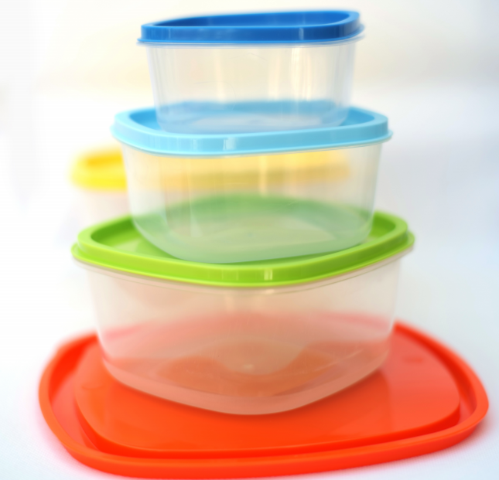
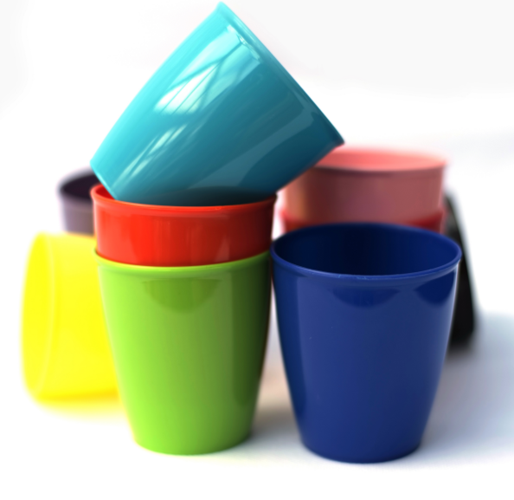
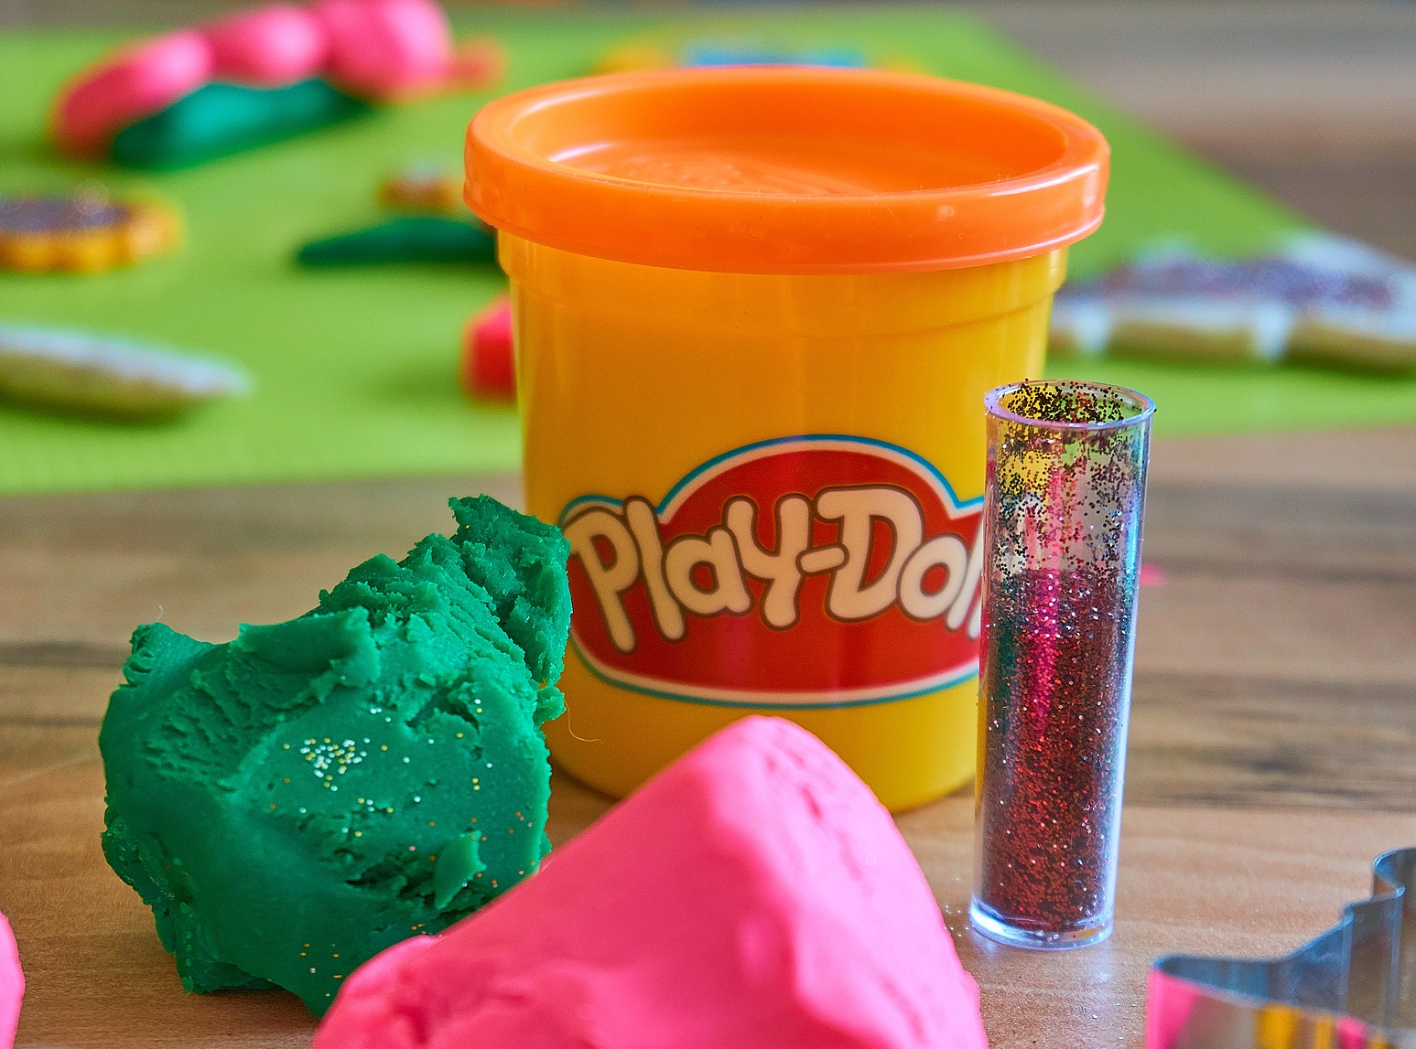
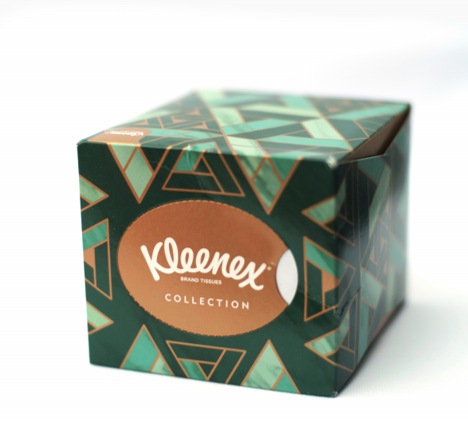
What can a child learn?
Let’s see if you can think of what a child could learn from their environment
Let’s look at each item and think about how a child could use each item and what they could learn
Notes:
Script:
We have Play-Doh, tissues, plastic cups and plastic containers. You will either have these items in front of you or as images on the slides. Have a look at each item and have a think about what a child could learn by using or playing with the Play Doh/toilet paper roll/plastic containers/plastic cups. If we were to give this to a child, what could they do with it and what would they learn from that interaction?

Slide 5
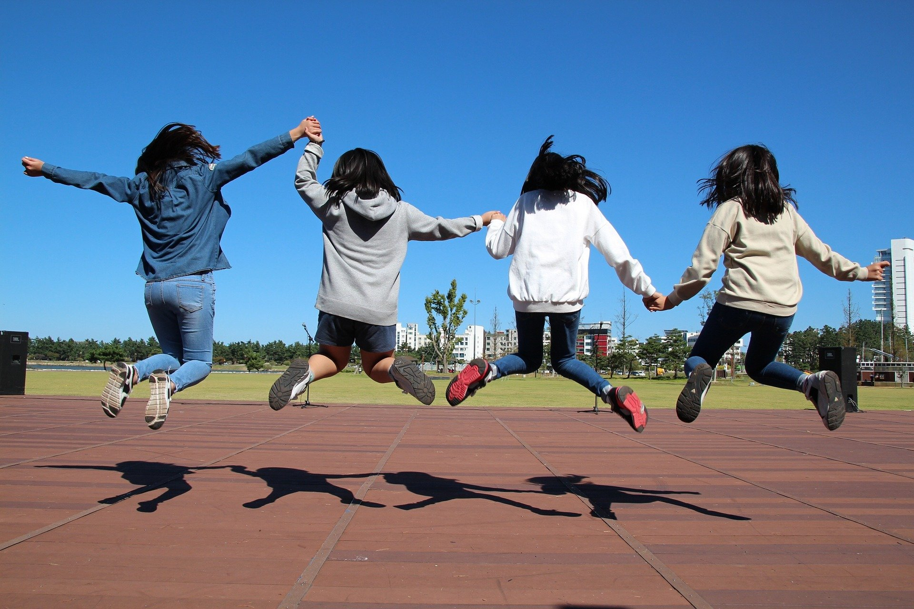
Review activity - ideas
Play Doh: textures, colours, making shapes, practising fine motor skills (i.e. rolling, squishing, pulling)
Tissue boxes: textures, fine motor skills (i.e. pulling, ripping, rolling into a ball), stack boxes
Plastic cups: colours, stack them, volume, how to drink from a cup
Plastic containers: stack them, colours of lids, different sizes, fill it with toys or other items
Notes:
Script:
Well done. I am sure you shared some very creative ideas.
So, let's summarise some of them. With Play-Doh, a child could learn about the different textures and colours that Play-Doh has. They could also use it to make shapes and use their fine motor skills while doing that, like rolling, squishing and pulling. With the tissue box, a child could learn about the texture again and that tissues are soft, but also practice their fine motor skills by pulling and ripping the tissues or rolling a tissue into a ball. With the plastic cups, children could learn about the various colours of the cups, and about height and volume if they wanted to stack them high and then see how much of a liquid the cups could hold. They could also practice how to drink for these cups. Finally with the plastic containers, children could stack them, learn about colours from the different colours of the lids, they could learn about different sizes by trying to match the lids with the containers and by putting the smaller containers into the bigger ones. They could also fill the containers with toys or other items to see how many items each container can hold.

Slide 6
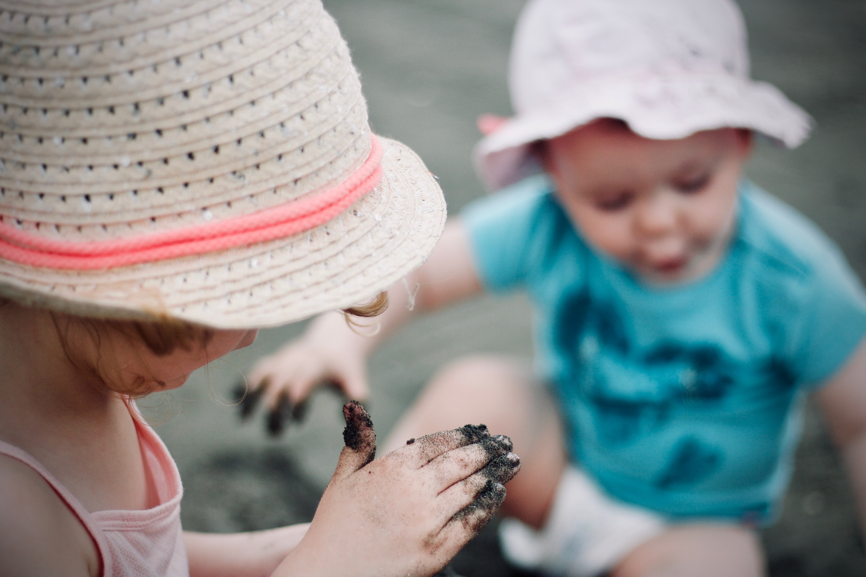
Review activity
Through this activity, you found ways that children could learn by using everyday items
This has perhaps made you think more closely about the items and individuals that are surrounding children, which can help them learn so much
Notes:
Script: ​
To summarise the key messages, in this activity you thought about ways that children could learn by using everyday items. I hope that this has made you think more about how children learn and about the items and individuals that surround children, which can help them learn so much about the world, as well as developing their own skills.

