Slide 1
Course information and employability
BA (Hons) Childhood
BA (Hons) Childhood: Primary Education with QTS

Slide 2
BA (Hons) Childhood
Focuses on the multi-disciplinary nature of the study of childhood, which embraces diverse academic disciplines such as sociology, education, psychology, history, philosophy, social policy and health
A variety of discreet pathways are available, allowing students to acquire specific knowledge and understanding in specialised aspects of childhood and their associated career opportunities
3 year degree, 120 credits per year, 20 credits per module

Slide 3
BA (Hons) Childhood - Year 1
Modules exploring a range of academic disciplines:
Child development in context
Health and Wellbeing
Childhood, care and education
Children in society
Diversity, rights and inclusion
Understanding university

Slide 4
BA (Hons) Childhood – Years 2 and 3
Essential modules: (60 credits per year)
Y2 Understanding Research - Y3 Dissertation
Y2 Safeguarding - Y3 Decolonisation and difference
Y2 Children’s ecologies
Pathways modules (60 credits per year)
Pathway 1: Disability, Health and Wellbeing
Pathway 2: Society and Welfare
Pathway 3: Education
Notes:
Pathway 1: Disability, Special Needs, Health and Wellbeing: This pathway offers a grounding in human development from an ecological perspective; health, well-being; and disability, from both a bio-psycho-social perspective and the disability-studies, rights-based approach.
Pathway 2: Society and Welfare: This pathway examines welfare ideologies and the ways in which childhood is constructed within the social structures. It explores the welfare needs of children through local, national and international institutions.
Pathway 3: Education: This pathway provides an opportunity for students to examine early and primary education and the underpinning values of professional practice.

Slide 5
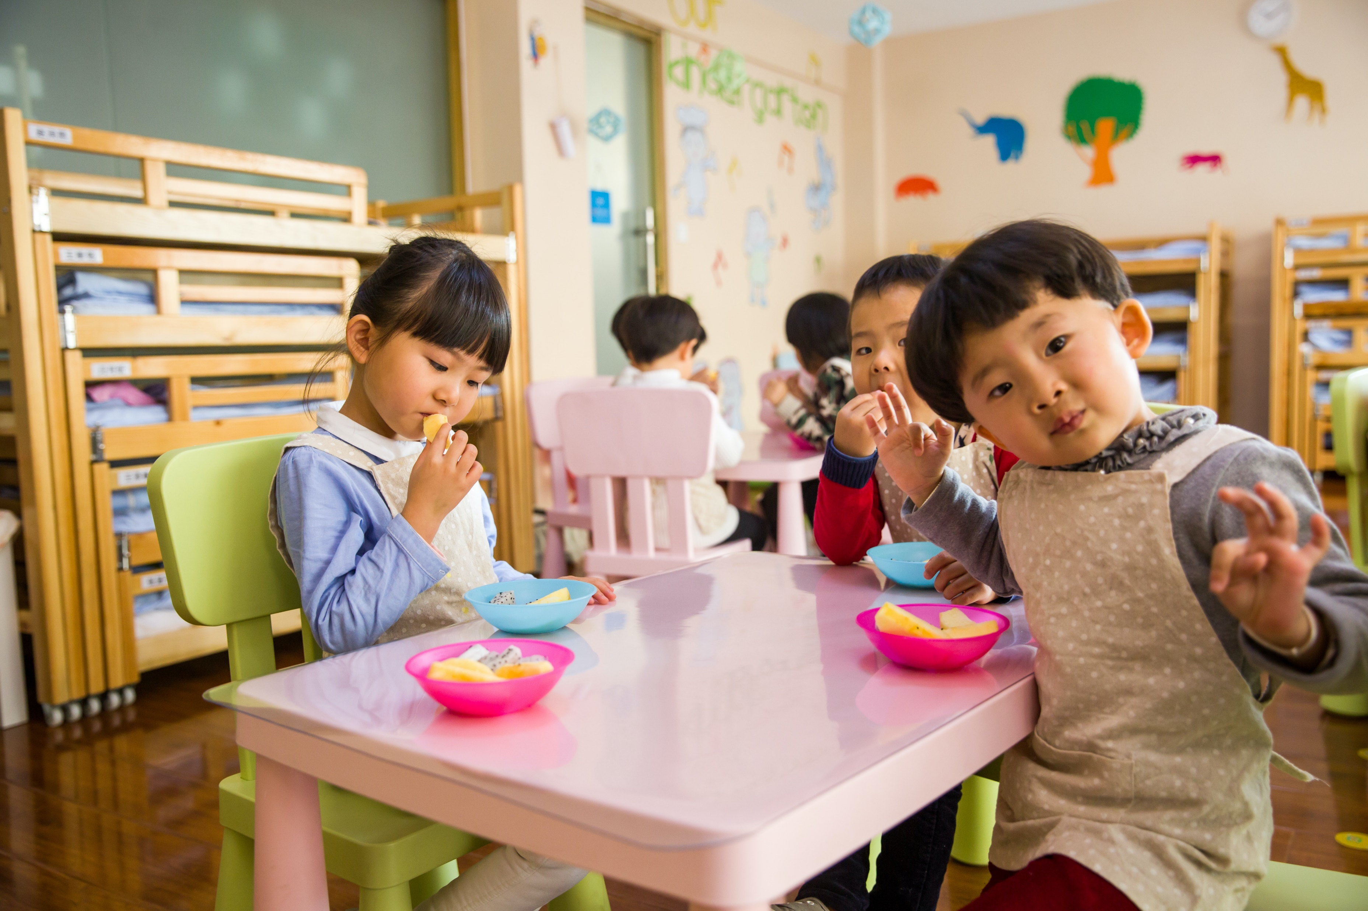
BA (Hons) Childhood – practice opportunities
Practice modules allow for students to gain experience within Early Years and Primary Education settings.
Early Childhood Graduate Competencies: additional certification possibility, within Education pathway. Developed by the Early Childhood Degree Network (ECSDN) and supported by the Department for Education (DfE).
Work experience available in programme.
Practice opportunities may be impacted by restrictions due to Covid-19.

Slide 6
BA (Hons) Childhood : Primary Education with Qualified Teacher Status (QTS)
For students who aspire to gain a teacher qualification alongside a BA Honours degree.
Partnership between UOS – BA Childhood and Initial Teacher Training (ITT) partners – North Essex Teacher Training and Suffolk and Norfolk SCITT.
Combination of full-time study with school placements throughout each year of the course
Competitive and selective
Unique in the region!

Slide 7
BA (Hons) Childhood: Primary Education with QTS - programme structure
 | BA (Hons) Childhood | ITT/QTS
Year 1 | All year 1 modules 120 credits | Yearlong practice, arrangement to be confirmed
Year 2 | Childhood requisite modules 60 credits | 60 credits professional studies, core QTS modules yearlong practice, arrangement to be confirmed
Year 3 | Childhood requisite modules 60 credits | 60 credits professional studies, core QTS modules Yearlong practice, arrangement to be confirmed

Slide 8
You might be currently studying:
Childcare
Early years
Health
Psychology
Sociology
Safeguarding
Children’s development
Children’s play
Education
Support needs
Physical Education
Social Science
Social care
Supporting Teaching and Learning

Slide 9
Postgraduate study and employment
Employment
Children’s and Family Services,
Community Psychology services,
Family support work,
Educational settings,
Charities, Child/Family advocates,
Nursery/Day care management,
Early Years Practitioners,
Therapy Services, …
Post Graduate Studies
Initial Teacher Training,
Social work,
Occupational Therapy,
Speech and Language Therapy,…
MA Childhood
MA Education
at the University of Suffolk

Slide 10
Applying For BA (hons) Childhood
Entry Requirements
112 UCAS tariff points
Equivalent to: BBC at A level, DMM at CACHE/BTEC
GCSE Maths and English grade 4/C or above (or equivalent)
Applicants wishing to later apply for teacher training with require GCSE Maths, English and Science at Grades 4/C or above, to do so.
Personal Statements
Show academic interest and insight into the course
Provide information about relevant work experience or transferable skills
Apply through UCAS for entry in September

Slide 11
Applying For BA (hons) Childhood:
Primary Education with QTS
Entry Requirements
120 UCAS tariff points
Equivalent to: BBB at A level
GCSE Maths, English and Science grade 4/C or above (or equivalent)
Apply through UCAS for entry in September
Selection process:
Personal statement: showing academic interest and insight, provide information about relevant work experience or transferable skills
Interview process
Before starting the course, students will also need to meet ITT Criteria set out by the DfE
Satisfactory enhanced DBS check
Demonstrate that they are ‘Fit to Teach’ by undertaking an occupational health assessment

Slide 12
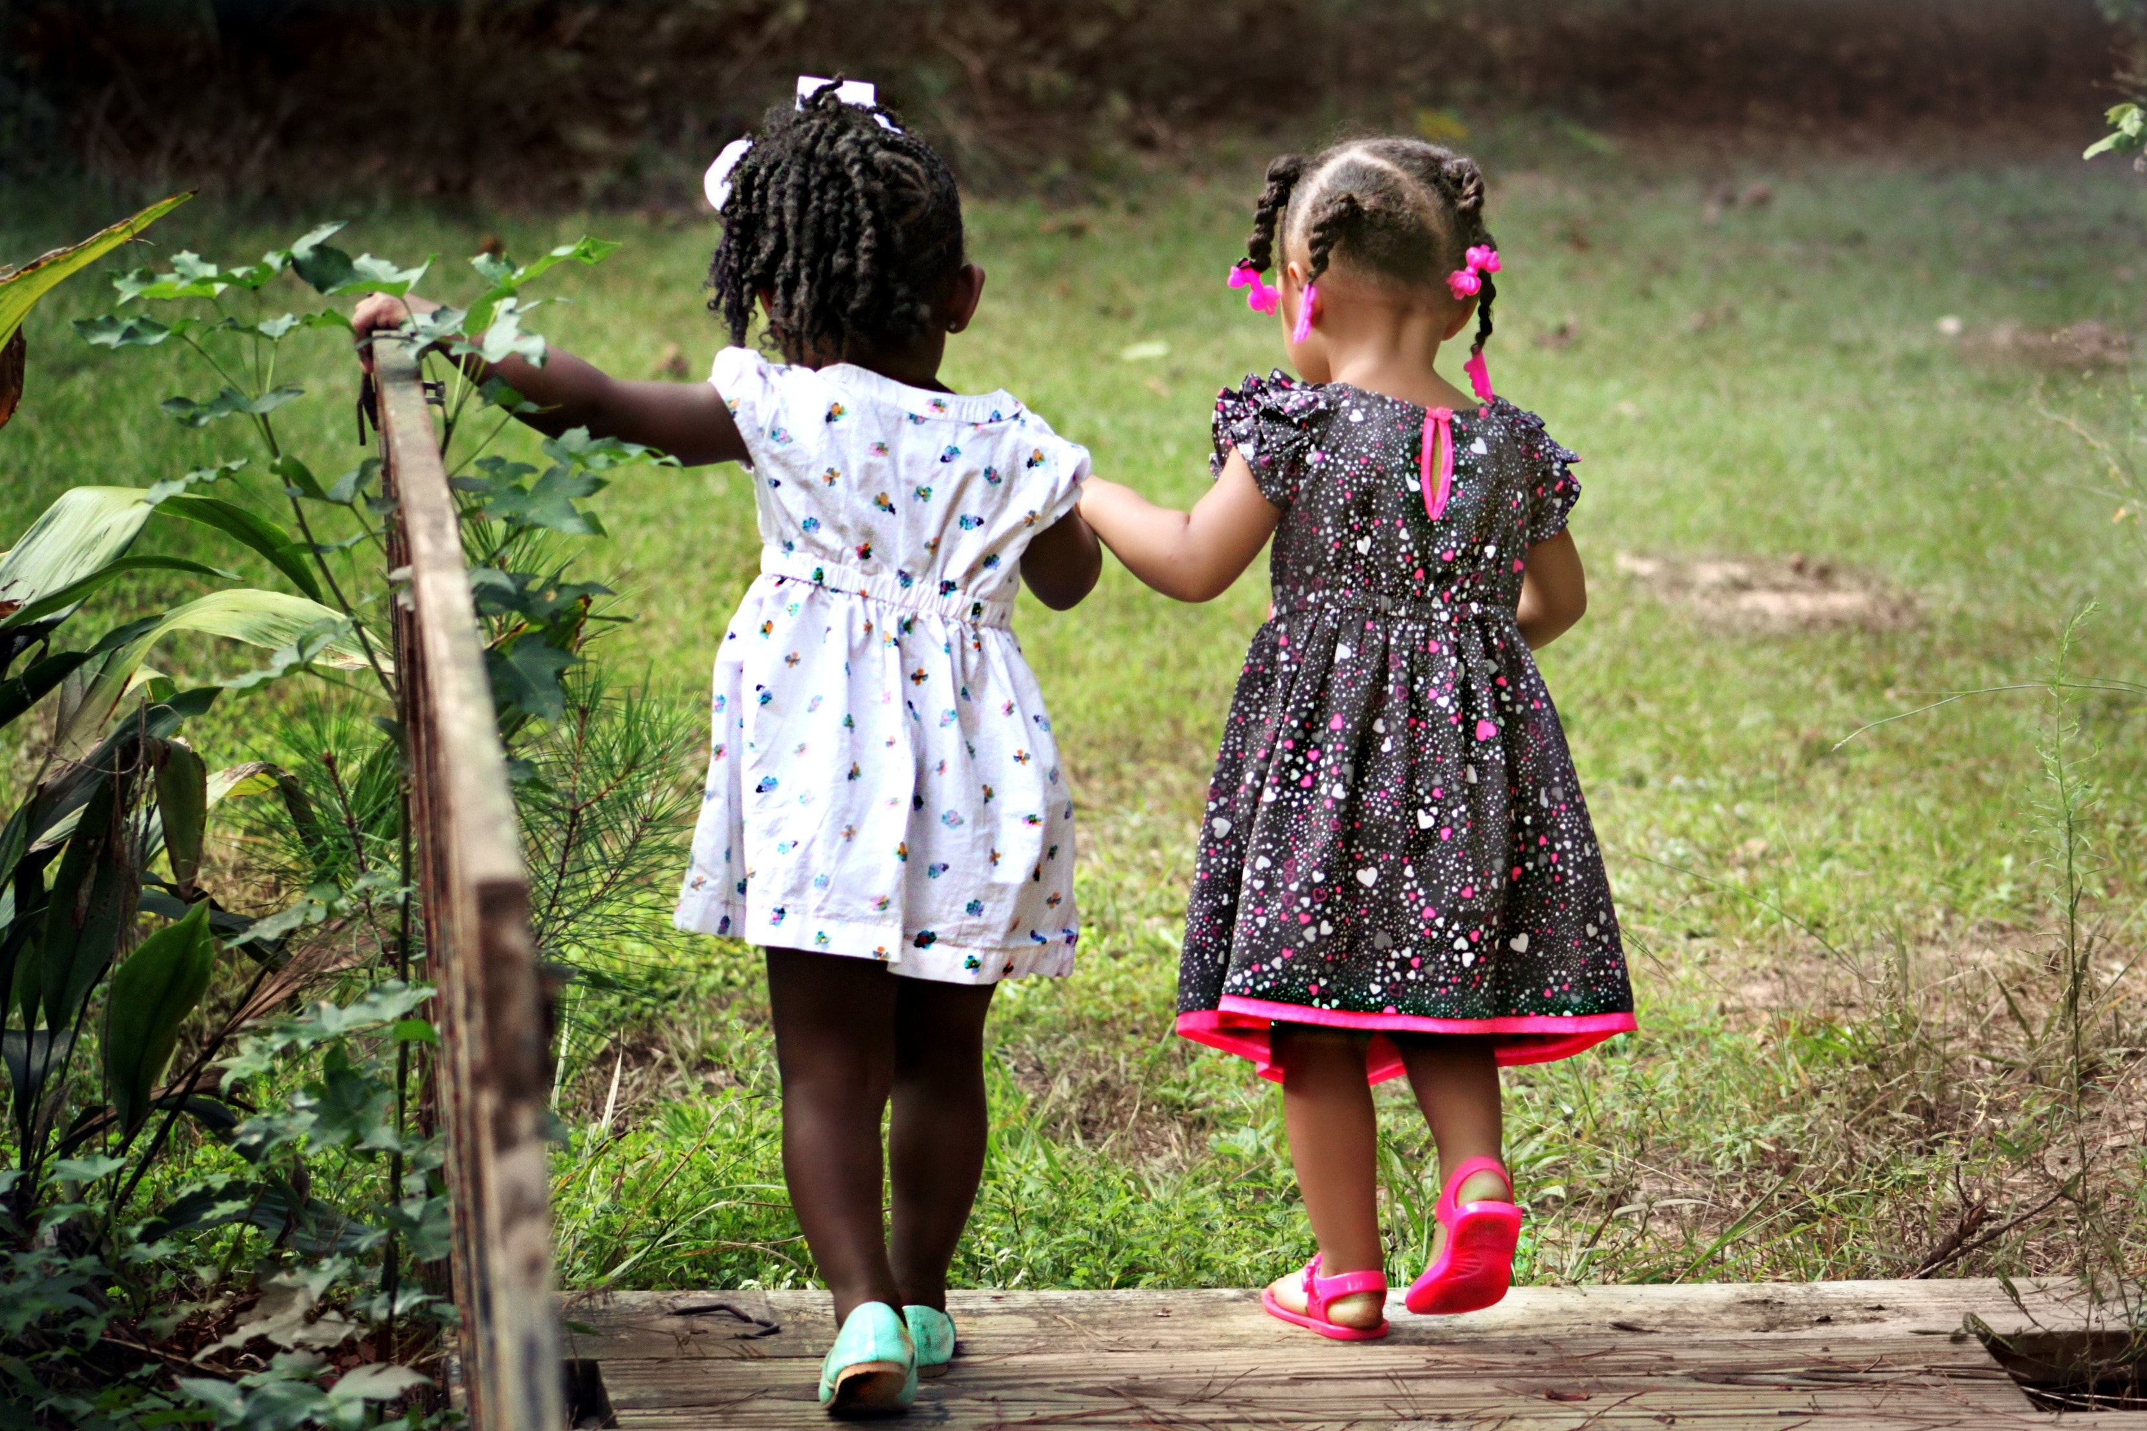
Thank you for listening !
We hope you enjoyed this lesson and we hope it has made you think about how we view children, childhood, families and education and also encouraged you to study this fascinating subject at the University of Suffolk

